Slide 1
CMPE 321
Binary Convertion
Boolean Algebra
K-Map
Encoder Decoder MUX
Review

Slide 2
Binary Convertion
Number | 126 | Divide by 2
Result | 68 | Remainder | 0 (Least Significant Bit)
Result | 34 | Remainder | 0
Result | 17 | Remainder | 0
Result | 8 | Remainder | 1
Result | 4 | Remainder | 0
Result | 2 | Remainder | 0
Result | 1 | Remainder | 1 (Most Significant Bit)
126 equals to |  | 1001000
Positive Numbers
For the integer part we continnue to divide by 2 till the result part is smaller than 2.
Then we write the numbers from the remainder from most significant bit to least significant bit.

Slide 3
Binary Convertion
Number | 32.125
For the integer part -> 32 |  | Divide by 2
Result | 16 | Remainder | 0 (Least Significant Bit)
Result | 8 | Remainder | 0
Result | 4 | Remainder | 0
Result | 2 | Remainder | 0
Result | 1 | Remainder | 1 (Most Significant Bit)
For the decimal part ->0.125 |  | Multibly by 2
Result | 0.250 | Integer | 0 (Most Significant Bit)
Result | 0.500 | Integer | 0
Result | 1.000 | Integer | 1(Least Significant Bit)
Number 32.125 |  | 10000.001
Positive double number.
Integer part will be divided by 2
While decimal part will be multiplied by 2
The Integer part start with LSB.
The part after decimal point start with MSB

Slide 4
2’ s Complement – Negative numbers
In order to find negative number first find the binary equalent.
Convert all 1s into 0s, and all 0s into 1s. Then add 1.
Positive Number
00010111 | 1’s Complement
Invert 0s and 1s | 11101000 | 2’s Complement
 | Add 1 | 11101001

Slide 5
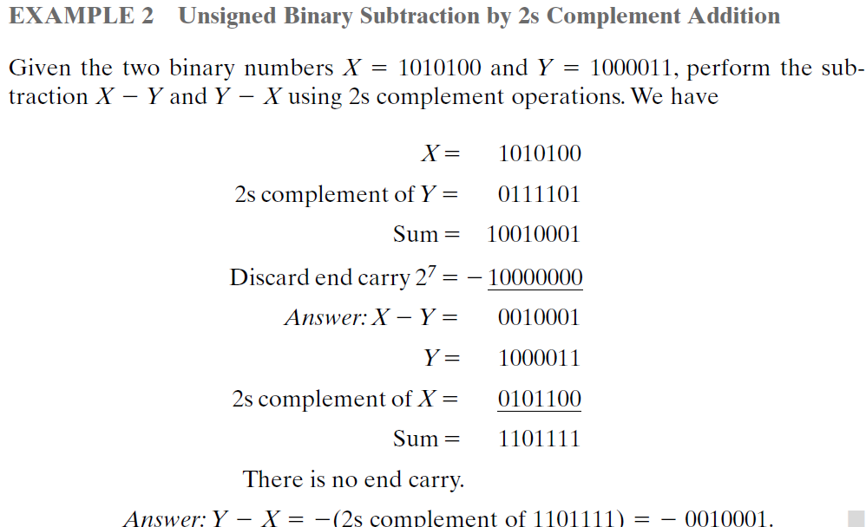
2’ s Complement

Slide 6
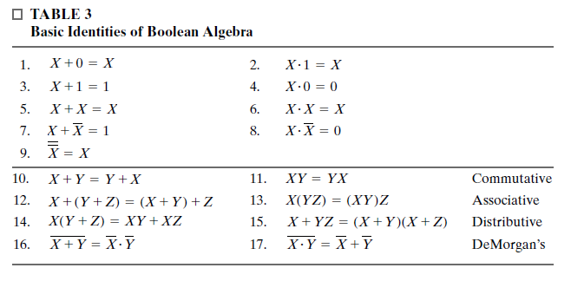
Boolean Algebra Basic Rules

Slide 7
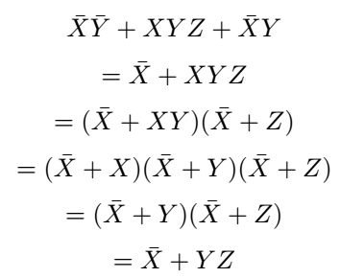
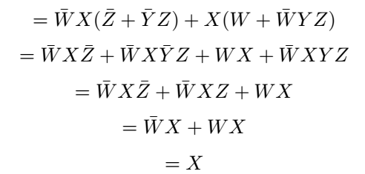
Boolean Algebra Example
Question 1
Question 2

Slide 8
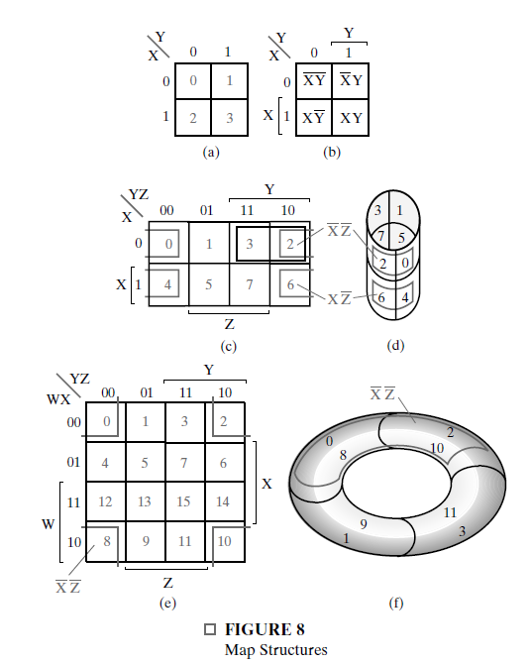
K- MAPS
Map structures.
2 variables
3 variables
4 variables maps.

Slide 9

K- MAPS
Truth Table
Boolean Algebra
A | B | C | F(ABC)
0 | 0 | 0 | 1
0 | 0 | 1 | 1
0 | 1 | 0 | 0
0 | 1 | 1 | 0
1 | 0 | 0 | 0
1 | 0 | 1 | 1
1 | 1 | 0 | 0
1 | 1 | 1 | 1
3 Variable K-MAP
 |  | AB
 |  | 00 | 01 | 11 | 10
C | 0 | 1 | 0 | 0 | 0
 | 1 | 1 | 0 | 1 | 1

Slide 10

K- MAPS
Truth Table
A | B | C | D | F(ABCD)
0 | 0 | 0 | 0 | 0
0 | 0 | 0 | 1 | 0
0 | 0 | 1 | 0 | 1
0 | 0 | 1 | 1 | 0
0 | 1 | 0 | 0 | 0
0 | 1 | 0 | 1 | 0
0 | 1 | 1 | 0 | 0
0 | 1 | 1 | 1 | 0
1 | 0 | 0 | 0 | 1
1 | 0 | 0 | 1 | 1
1 | 0 | 1 | 0 | 1
1 | 0 | 1 | 1 | 0
1 | 1 | 0 | 0 | 1
1 | 1 | 0 | 1 | 1
1 | 1 | 1 | 0 | 0
1 | 1 | 1 | 1 | 0
Boolean Algebra
4 Variable K-MAP
 |  | AB
 |  | 00 | 01 | 11 | 10
CD | 00 | 0 | 0 | 1 | 1
 | 01 | 0 | 0 | 1 | 1
 | 11 | 0 | 0 | 0 | 0
 | 10 | 1 | 0 | 0 | 1

Slide 11
Minterm – Maxterm
Minterm : It is defined as the product term of n variables, in which each of the n variables will appear once either in its complemented or un-complemented form. The min term is denoted as mi where i is in the range of 0 ≤ i < 2ⁿ.
A variable is in complemented form, if its value is assigned to 0, and the variable is un-complimented form, if its value is assigned to 1.
A max term is defined as the product of n variables, within the range of 0 ≤ i < 2ⁿ. The max term is denoted as Mi. In max term, each variable is complimented, if its value is assigned to 1, and each variable is un-complimented if its value is assigned to 0.
Maxterm: Minterms and Maxterm are complement of each other.
Mi = mi
Resources: https://www.electronicshub.org/boolean-logic-sop-form-pos-form/

Slide 12
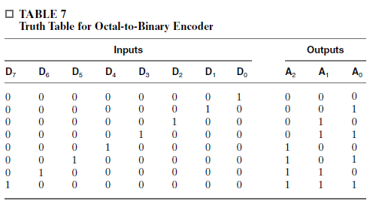

Encoder
An encoder is a digital function that performs the inverse operation of a decoder.
An encoder has 2n (or fewer) input lines and n output lines. The output lines generate the binary code corresponding to the input value.

Slide 13
Decoder
a combinational circuit with an n-bit binary code applied to its inputs and an m-bit binary code appearing at the outputs.
The decoder may have unused bit combinations on its inputs for which no corresponding m-bit code appears at the outputs.

Slide 14

Example from the book

Slide 15
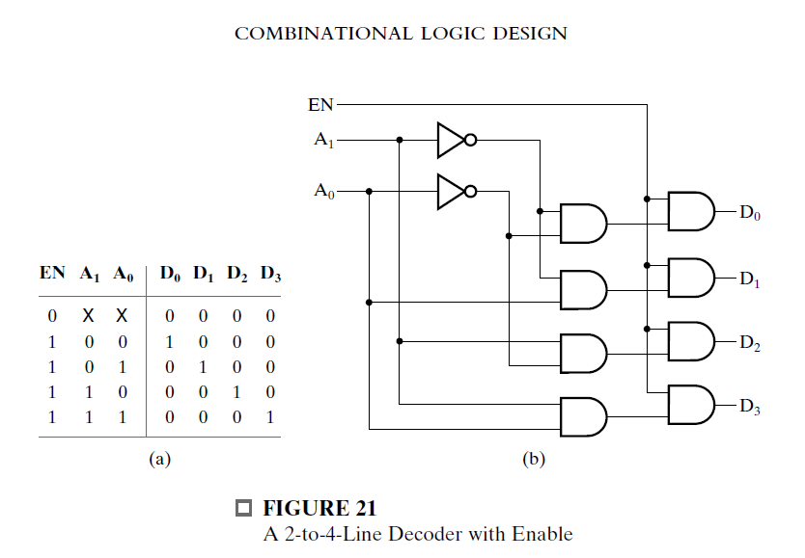
Example from the book

